Slide 1
PERFORMING ARTS
DANCE

Slide 2
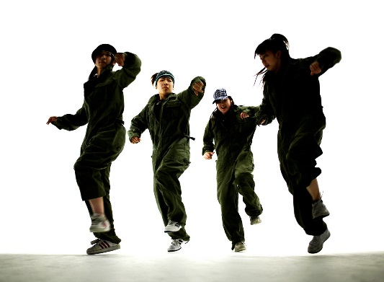
Lesson Objective
Participate in an effective warm showing focus, energy and determination.
Learn a routine the uses the 5 basic actions and identify them!

Slide 3
Success Criteria
Level | Dance Strand
 | 1 Creating | 2 Performing | 3 Reflecting
Entry | I can remember a range of actions I can create phrases based on a stimulus or music | I can participate in a short group performance I show some consideration of spatial awareness in performance | I can recognise when my own work and the work of others’, could be improved
1 | I can perform simple dance phrase demonstrating choreographic skills | I can use appropriate characterisation in a performance | I can talk about why I made certain decisions in my choreography I can show a basic understanding of how a stimuli can be conveyed
2 | I can create a choreography using unison and cannon I can learn teacher led sequences and then use these to develop my own levels I can create a choreography using a range of stimuli I can take on feedback to improve my choreography such as using levels and/or contract work I can sustain a focus within a performance | I can learn a routine and take part in simple performances | I can give suggestions on how work could be improved I can talk about my work using some dance terminology I can identify strengths and weaknesses in my own and others work
3 | I can select and apply movement to match the given dance style I can work confidently in a group using a range of choreographic devices to explore different dance styles and ideas I can create and rehearse performance that make use of the range of techniques and dynamics to express my ideas I can give and accept suggestions to/from peers and teachers during the rehearsal process I can learn and create dances in a variety of styles | I experiment with different actions to create a performance I can create routines that are appropriate to the given style or stimuli I can experiment with different styles/actions and dynamics when developing a routine I improve and refine my performance through the rehearsal process I can choreograph a short performance for an audience I can perform a variety of different dance styles | I can reflect on and evaluate my own and other pupils’ work, suggesting improvements I can use key words when talking about dances that I have seen or participated in I can discuss the ways that ideas are communicated

Slide 4

FIZZ BUZZ
YOU HAVE TO JUMP FOR FIZZ AND SPIN FOR BUZZ
All pupils stand in a circle in the room. Go round the circle counting from one upwards, in number order. If a pupil says a multiple of 3 they JUMP and if they say a multiple of 5 they say SPIN. If they say a multiple of 3 and its also a multiple of 5 then they say JUMP AND SPIN at the same time.
Skills Required
Listening to others
Knowing your timetables
Thinking quickly
Concentrating
BE AWARE OF YOUR SPACE!

Slide 5
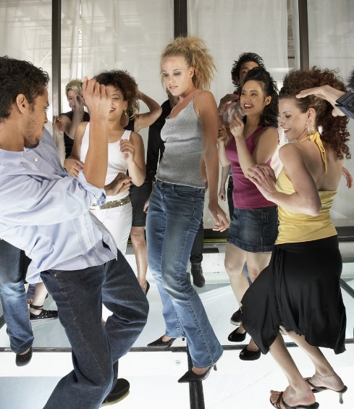
DANCE LITERACY-KEY WORDS
ACTION-WHAT
DYNAMIC-HOW
SPACE-WHERE
RELATIONSHIPS-WHO
RHYTHM-TIMING
FOCUS

Slide 6
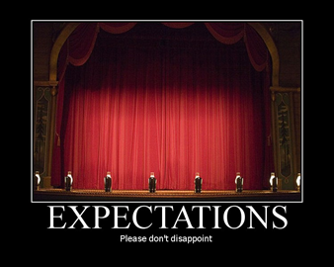

RECAP OF DANCE EXPECTATIONS
BE RESPECTFUL OF OTHERS IN THE CLASS.
TRY YOUR HARDEST AT ALL TIMES.
LISTEN TO FEEDBACK AND USE THIS CONSTRUCTIVELY TO IMPROVE YOUR PERFORMANCE.
LISTEN TO THE TEACHER AT ALL TIMES.
BE ABLE TO WORK AS A GROUP AND INDEPENDENTLY.
BE CREATIVE.
USE THE STAGE EFFECTIVELY.
LISTEN TO YOUR PEERS IDEAS

Slide 7

WARM UP RECAP- HANDS UP
WHY DO WE NEED TO WARM UP?
WHAT WILL HAPPEN IF WE DO NOT WARM UP PROPERLY?
HOW LONG DO WE HOLD A STRETCH FOR?
WHAT ARE THE KEY ASPECTS OF A WARMUP?

Slide 8
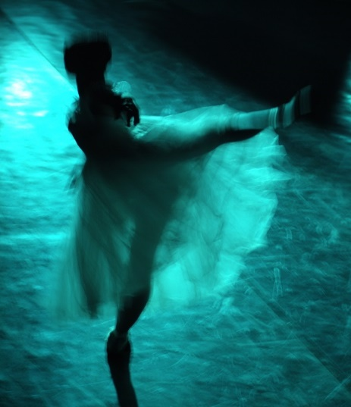
WARM UP?
A warm up has 3 sections-
Pulser raiser- Getting the blood pumping around the body.
Co-ordination- moving 2 parts of the body at the same time.
Stretch- getting rid of lactic acid. Hold for 8-10 seconds.

Slide 9
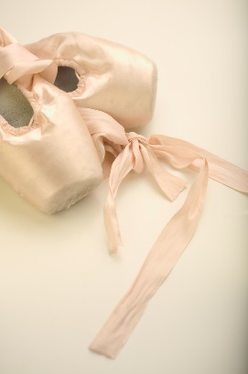
5 BASIC ACTIONS
The 5 basic actions are
Jump
Hop
Travel
Stillness/gesture
Turn/rotate

Slide 10


TASK.
WHO CAN REMEMBER THE START OF THE STREET DANCE ROUTINE FROM LAST WEEK????????????????
YOU HAVE 2 MINUTES TO REHEARSE AND RECAP.

Slide 11
STREET DANCE
We are now going to learn section 2 of the street dance routine.
How many of the 5 basic actions can you identify?
REMEMBER TO COUNT!

Slide 12

EXTENSION TASK PERFORMANCE!
In 2 groups you will now perform the routine to each other.
LEVEL CHECK!
DON’T worry if you go wrong- carry on and smile!

Slide 13
PLENARY
What have you learnt today?
What are the 5 basic actions?
Why do we arm up?
What are the key aspects of a warm up?
Each corner of the room is a level. Go to the corner you think you are at and be ready to explain why and how you could improve.

